Slide 1

Removing Diffraction from X-ray Fluorescence Spectra for HfO2 Thin Film Characterization
Sonia Ghoshal
Mentor: Dr. Donald Windover
Div 643, Group 02

Slide 2

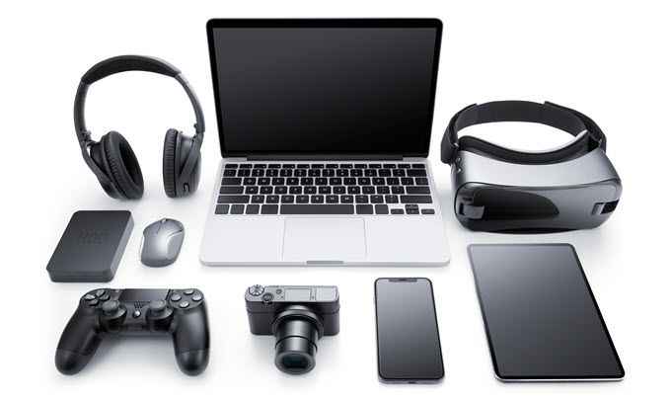
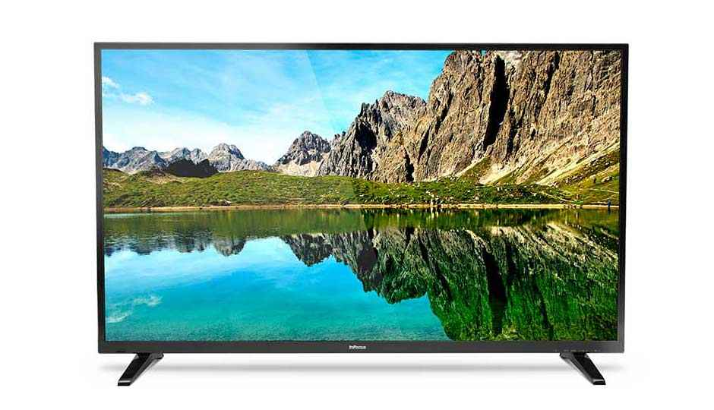
Motivation: Transistors
Gate
Source
Drain
Gate oxide (HfO2)
n+
n-channel
n+
p-type substrate (Si)

Slide 3
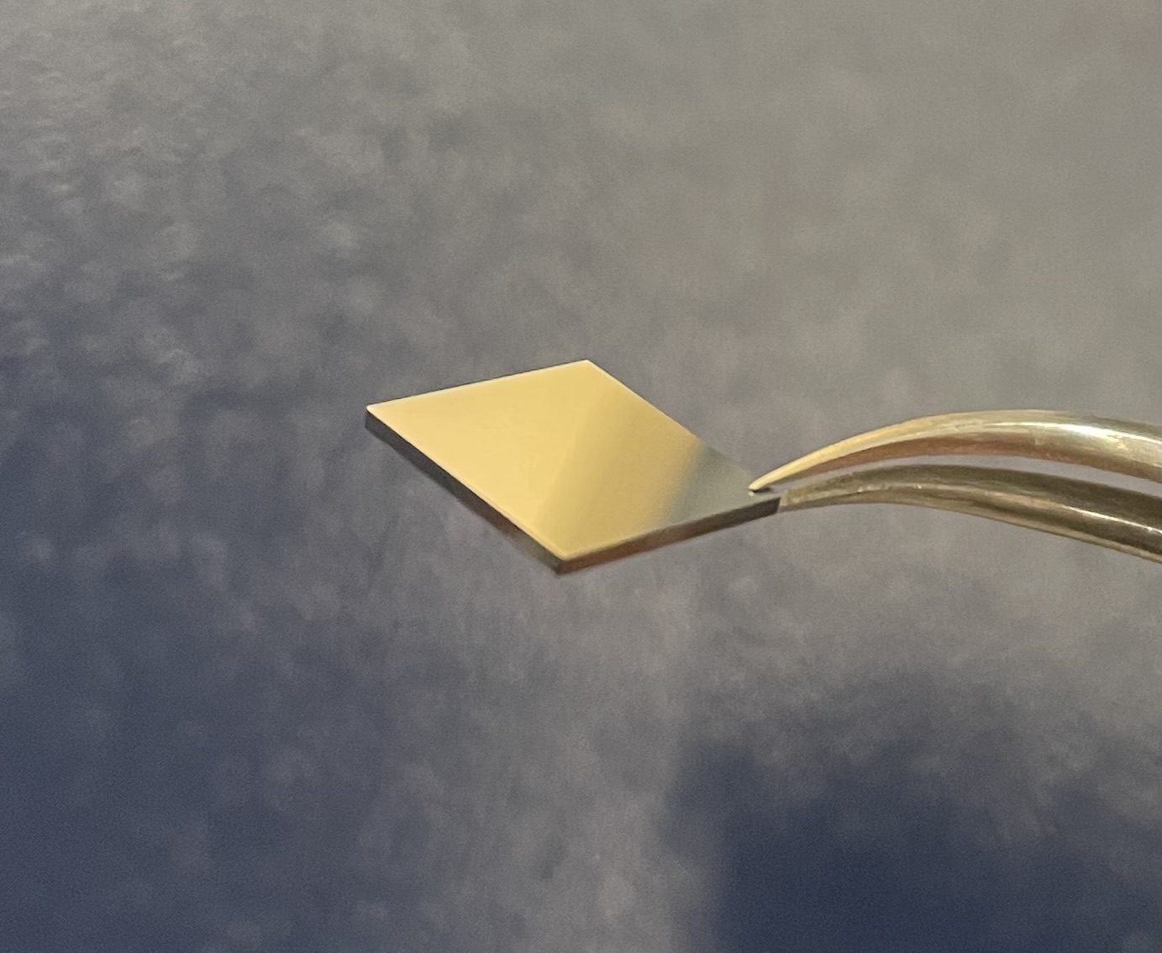
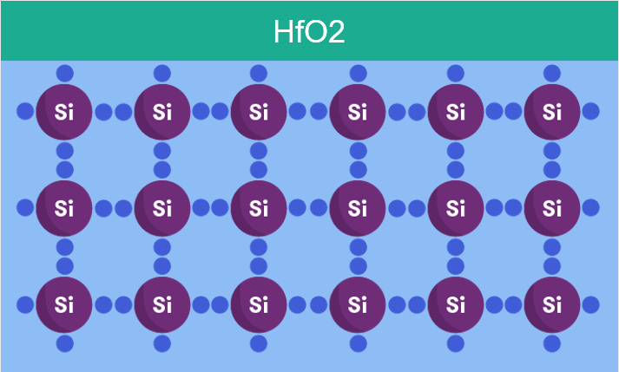
Goal
Assess the qualities of HfO2 films from manufacturers (thickness, impurities, elemental composition)

Slide 4
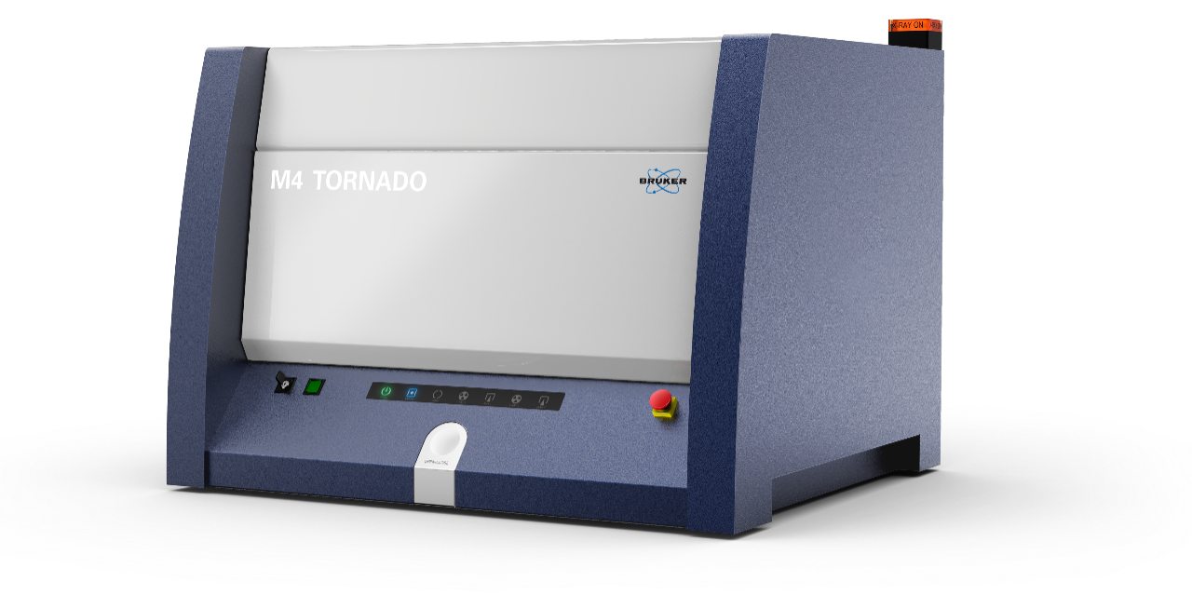
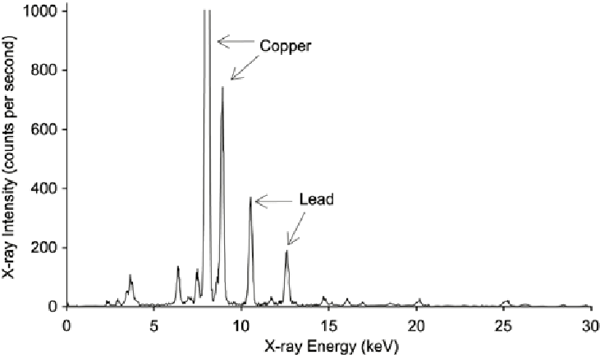
Tool: Micro-X-ray Fluorescence
x-ray source
XRF Spectra
x-ray beam
detector
sample
fluorescence
“fingerprint”
= Tells us what elements are in a sample

Slide 5
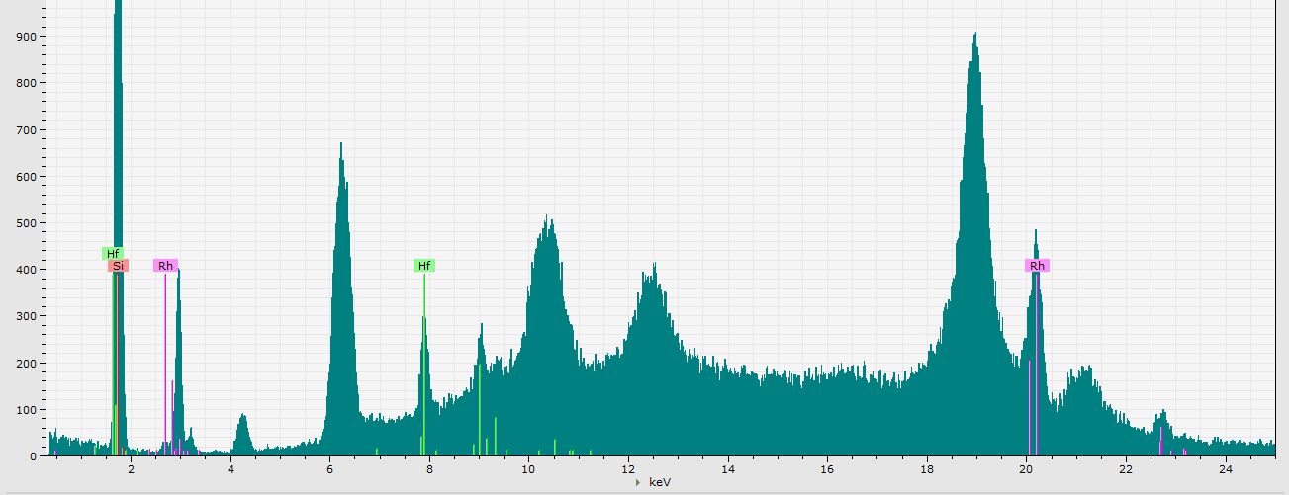
Problem: Diffraction
Light passing through a small slit scatters
= diffraction
Si lattice spacing → diffraction peaks
Diffraction peaks!

Slide 6
How do we remove diffraction?
rotate the sample
use software
apply filters

Slide 7

1) Filters
Thin sheets of Al, Ti, Cu
Purpose: decrease background radiation
TRADEOFF: removing noise at the expense of losing the actual signal
Findings: effective at reducing noise, but reduced Hf counts too much
x-ray source
x-ray beam
detector
sample

Slide 8
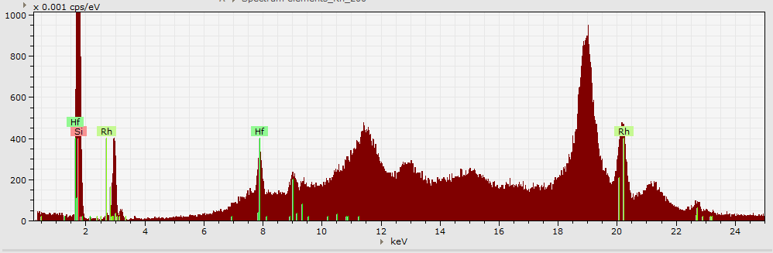
2) Rotation
Rotating the chip in the XY plane changes the diffraction pattern observed
Discovered that 40-45 degrees allows for the best separation of diffraction and fluorescence peaks
0°:

Slide 9
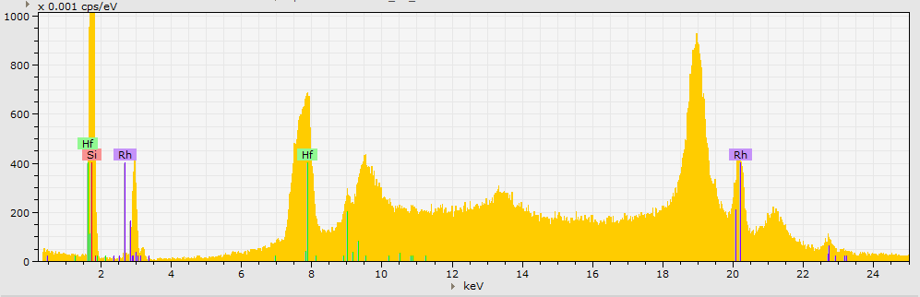
2) Rotation
Rotating the chip in the XY plane changes the diffraction pattern observed
Discovered that 40-45 degrees allows for the best separation of diffraction and fluorescence peaks
20°:

Slide 10
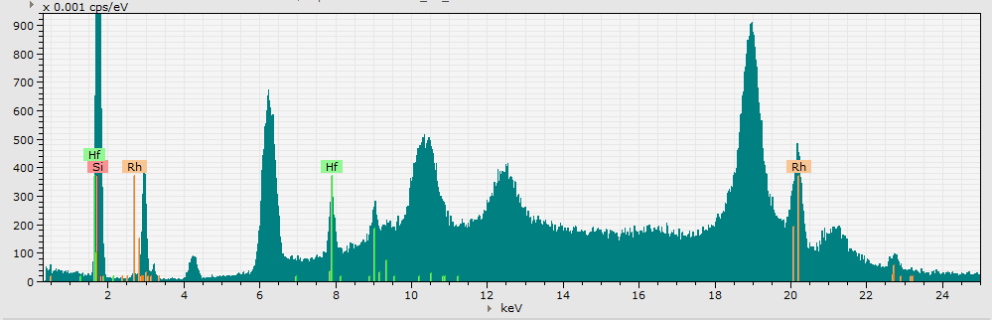
2) Rotation
Rotating the chip in the XY plane changes the diffraction pattern observed
Discovered that 40-45 degrees allows for the best separation of diffraction and fluorescence peaks
40°:

Slide 11
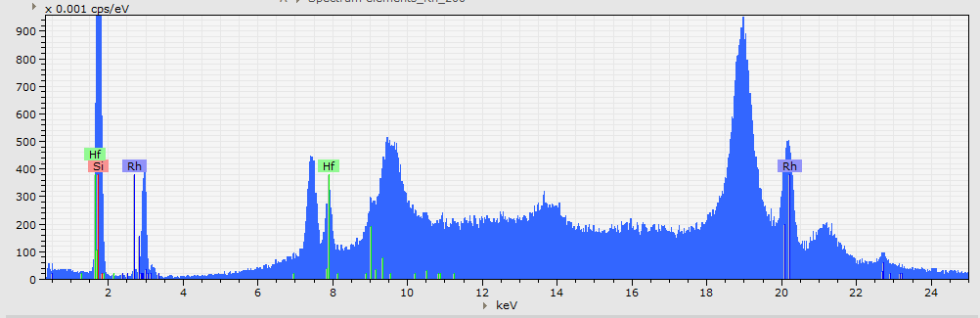
2) Rotation
Rotating the chip in the XY plane changes the diffraction pattern observed
Discovered that 40-45 degrees allows for the best separation of diffraction and fluorescence peaks
60°:

Slide 12
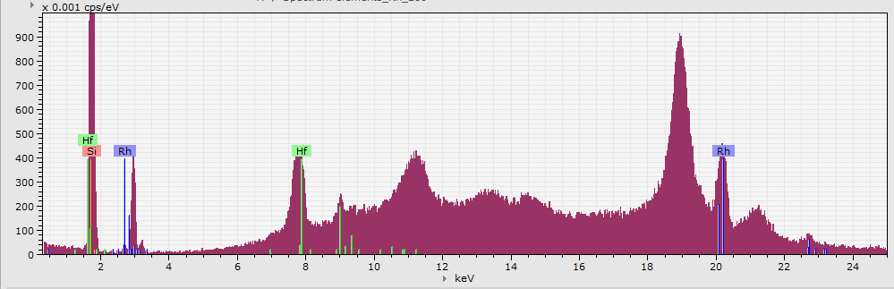
2) Rotation
Rotating the chip in the XY plane changes the diffraction pattern observed
Findings: 40°- 45°allows for the best separation of diffraction and fluorescence peaks
80°:

Slide 13
2) Rotation
Rotating the chip in the XY plane changes the diffraction pattern observed
Discovered that 40-45 degrees allows for the best separation of diffraction and fluorescence peaks
40°: best angle!

Slide 14
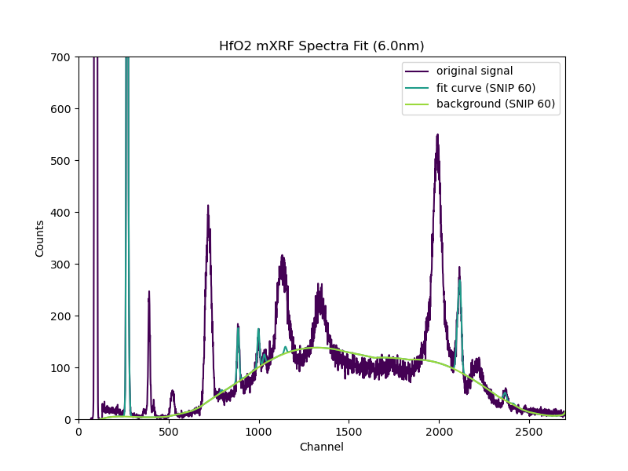
3) Using software:
Used PyMca software to model the true fluorescence peaks versus the background radiation
Hf

Slide 15
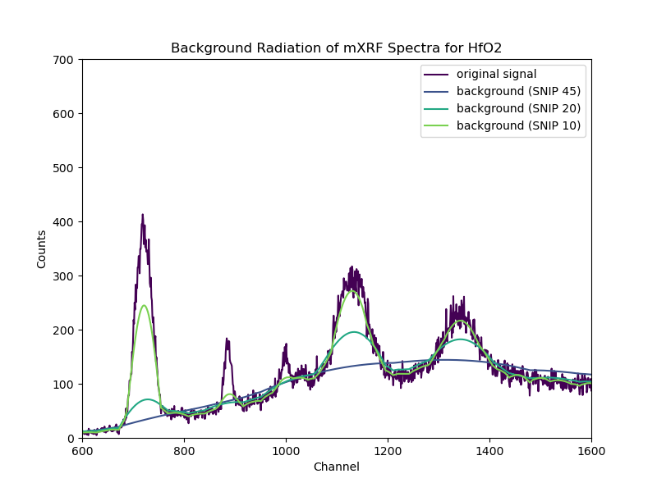
Finding the best fit:
Tested parameters to find the best fit
lower SNIP widths → more accurate fits
TRADEOFF: removing noise at the expense of losing the actual signal
Hf

Slide 16
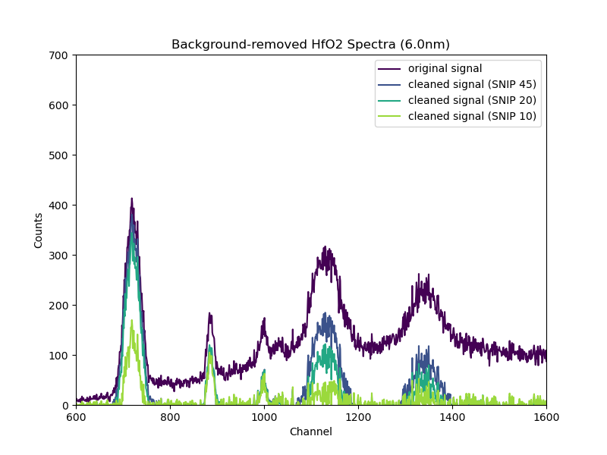
Computationally removing diffraction:
Removed background radiation to isolate the true fluorescence peaks
Findings: found a set of parameters (SNIP 10) that cleans up majority of diffraction while retaining Hf counts
Hf

Slide 17
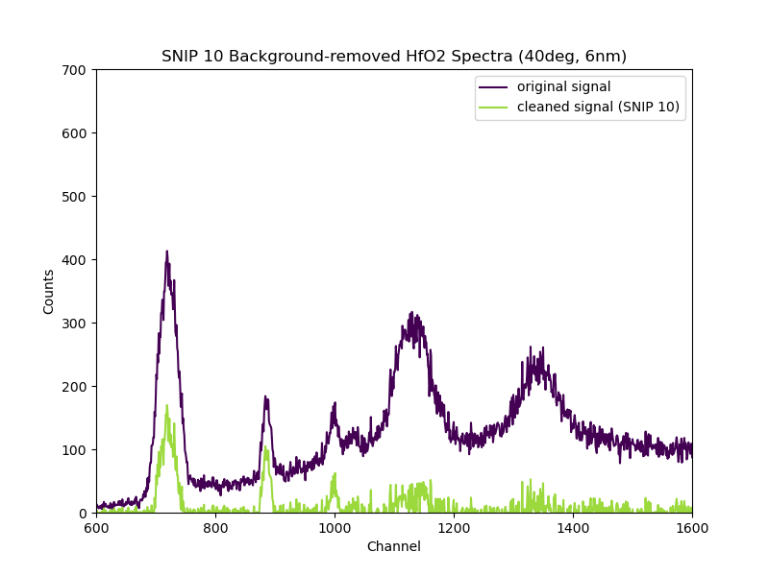
Recap
Rotating chip to ~ 40°- 45°, then using PyMca software with determined set of parameters allows for the removal of most of the diffraction and retainment of Hf counts
Hf

Slide 18
Questions?

